Slide 1
Software Engineering
Layered Technology
Process Framework

Slide 2
Layered Technology

Slide 3

The main objective of Layered Technology is to help software developers to obtain high-quality software

Slide 4
Quality Focus =
Define continuous process improvement principles of software
Efficiency, usability, maintenance and reusability are some of the requirements that need to be met by new software.
Process =
Foundation or base layer of Engineering
It binds all layers together that enable the development of software
Defines the framework that established for the effective delivery of software engineering technology
Covers all the activities, actions and tasks required to be carried out for software development
5 sublayers = Communication, Planning, Modeling, Construction, Deployment

Slide 5
Method =
Includes any technical knowledge and resources required for development, requirement analysis, modeling etc.
Provides the answers of all 'how-to' that are asked during the process
Tools =
It is an automated support for the software development
The tools are integrated i.e the information created by one tool can be used by the other tool.

Slide 6
Benefits of Layered Technology –
Better Decision =
The decisions outlined in each layer provide a structure for the whole project, unifying collaboration and problem-solving.
Early Error Detection =
The layered approach lends itself to identifying and solving errors early in the project.
Ease of Configuration and Maintenance =
Helpful feedback, timely testing, and constant communication help to make the end project easy to configure and maintain.

Slide 7
Process Framework

Slide 8
What is Software Process?
Set of activities and associated outcomes that produce software product
Model chosen for managing the creation of software from initial customer inception to release the final product
Software process includes:
Tasks – focus on a small, specific objective.
Action – set of tasks that produce a major work product.
Activities – group of related tasks and actions for a major objective.

Slide 9
What is Software Process Framework?
Software Process Framework is an abstraction of the software development process
It details the steps and chronological order of a process
Collection of Task Sets
Task sets consist of a collection of small work tasks, project milestones, work productivity and software quality assurance points.

Slide 10
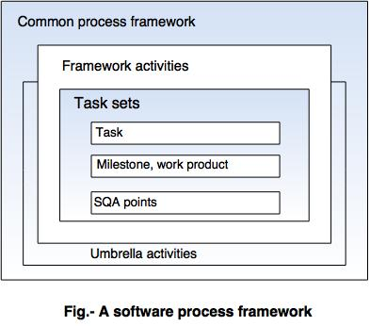

Slide 11
Process Framework Activities =
Defines five framework activities—communication, planning, modeling, construction, and deployment.
Communication: By communication, customer requirement gathering is done. Communication with consumers and stakeholders to determine the system’s objectives and the software’s requirements.
Planning: Establish engineering work plan, describes technical risk, lists resources requirements, work produced and defines work schedule.

Slide 12
Modeling: Architectural models and design to better understand the problem and for work towards the best solution. The software model is prepared by: - Analysis of requirements
- Design
Construction: Creating code, testing the system, fixing bugs, and confirming that all criteria are met. The software design is mapped into a code by:
- Code generation - Testing
Deployment: In this activity, a complete or non-complete product or software is represented to the customers to evaluate and give feedback. On the basis of their feedback, we modify the product for the supply of better products.

Slide 13
Process Flow =
Describes how the framework activities means the actions and tasks that occur within each framework activity
Linear Process Flow =
Executes each of the five framework activities in sequence, beginning with communication and culminating with deployment
Iterative Process Flow =
Repeats one or more of the activities before proceeding to the next

Slide 14
Evolutionary Process Flow =
Executes the activities in a “circular” manner
Parallel Process Flow =
Executes one or more activities in parallel with other activities

Slide 15
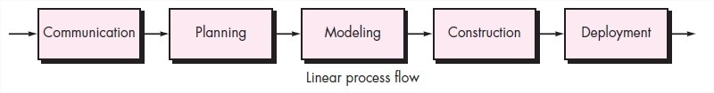
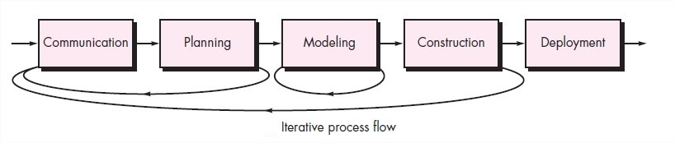
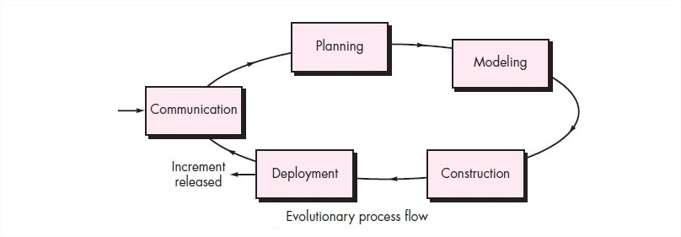

Slide 16
